Slide 1


DevRel Camp
Connecting as One
Notes:
Accessibility review:
Slide Deck numbers should be added to each slide in the bottom right or left hand corner
Add Alt Text to all images

Slide 2




Data Platform Security Principals 101 DevRel Camp Feb 2021

Slide 3
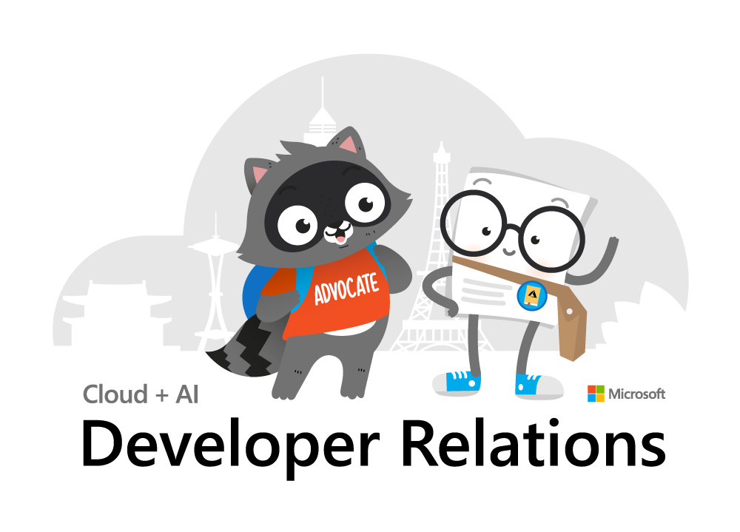
Inclusive Meeting Framework
Inclusive Meeting Framework Better experiences for everyone
Please practice these tips when in camp breakout sessions
Voice Guidance
Raise hand so the moderator can call on you.
State your name when speaking​ (every time).
Return to mute when not talking​.
Chat Guidance
Q: to preface questions
@mention to respond to an individual
Stay on topic
Use alt-text for images and gifs
Allyship
Seek to understand, not drive agreement.
Focus on ideas, not people.
Support & amplify peers​.
Avoid Acronyms
Created by Cory Fowler & Josee Martens https://aka.ms/bravespaces
Notes:
Show in every session to all attendees.
A reminder about our inclusive meeting framework, please mute now and if you have a question, raise your hand or mention it in Chat.
INTRODUCE MODERATOR

Slide 4
Agenda
Security Principles
SQL Authentication and Logins
RBAC
Azure SQL DB Differences
Database Object Security
Demo
Notes:
Today we’re going to cover a lot of important foundational material about security, accounts, authentication. For folks new to Microsoft SQL Server security design and administration, this will be a great foundation for your learning. I think there is content in here to interest everyone at different levels of experience with SQL Server. So I’m going to start basic, and build quickly from there, focusing my content on what we in DevRel could take away when we’re building demos and tutorials, so we can demonstrate exemplary security. Too often I find our own labs and walkthroughs scripting out shortcuts in security that end up in customer’s production systems.
I’m going to focus mostly on SQL Server and the SQL Server platforms in Azure today, I’m not going to talk about CosmosDB so much because that’s not where I lived in my past life as a SQL Server consultant and MVP or in my current role on the SQL Docs team.
Let’s get started!

Slide 5
Section Title 3
Authentication and Logins

Slide 6
Principal vs Principle
Principal
(noun) a person who is in charge of some responsibility
Example: The principal consultant talked to the school’s principal.
(adj) original, most important
Example: The principal aim of a good DBA is to defeat wicked developers.
Principle
(noun) a rule, guideline or fact
Example: Our guiding principles are based on science.
Notes:
So this is a common grammar issue in the English language, the difference between principal, P-A-L and principle, P-L-E.
Both can be a noun, but PAL describes a person, a person who could be your “pal”. A principle PLE is an inanimate thing, like guiding principles, or being principled, a way to describe someone who follows a moral or ethical code.
So today, we’re really talking about both today. Principals, PAL, are also what SQL Server calls security objects in the database. Principles, PLE, guide how we should design and create securables in our servers and database.

Slide 7
A Principal’s Principles
We can all be Principled Principals
who follow Principal Principles of security.
Notes:
My title at my last consulting company was Principal Consultant, so this past Principal is going to share with you his Security Principles.
And for this audience, I’m talking about the principles we principals demonstrate in our sample code, in our walkthroughs and guides, in our labs and sample code.

Slide 8
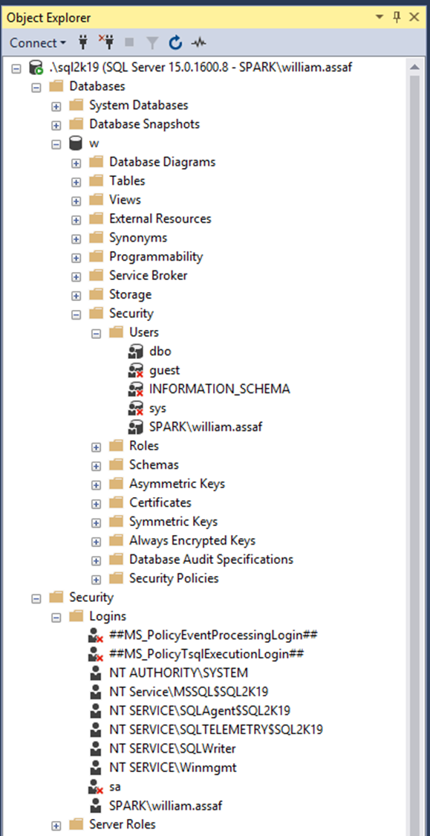
Login vs User
Database User
Server Login
Has a database context
Often linked to a Login*
Does not have a password*
Stored in a Database
Included in DB Restore
*Most of the time. We’ll talk about it.
Connects to a SQL Instance
Linked to AD (Windows Auth) or have a password (SQL Auth)
Stored in the Master system database, so is not included in other DB restores
Notes:
<read slide>
So over here in a screenshot from Object Explorer in SQL Server Management Studio, the Security folder under database has a subfolder for Users. The Security folder under server has a subfolder for Logins, and I’ve circled a login and a user here that have the same name.
So key takeaway here is that Logins handle authentication. Authentication can be through the trusted external system like Active Directory, or as an alternative, internally to the SQL Server in what’s called SQL Server authentication. SQL Server authentication on the face of it is simpler, contained, but we’ll talk about how that’s actually not advantageous for managing security.
Now, what have I already done wrong here?
I should create logins for to AD Security Groups, not individuals, not accounts with my name on it. Insist on it in tutorials, examples, walkthroughs. Whenever possible credentials should be created for groups, not individuals. It’s best to use a security system that already has groups for many other purposes… a system like Active Directory. We could create security groups inside each SQL Server for users inside each SQL Server, but that’s not a scalable solution, is it?

Slide 9
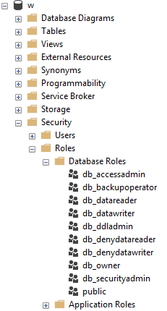
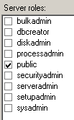
Server and Database Built-in Roles
Roles are security principals too
Logins added to Server Roles
Users added to Database Roles
Built-in Roles to provide a standard for access that may be too broad.
Follow principles of RBAC.
Notes:
<read slide first, after too broad> When granting permissions to a role, assign more specific permissions when possible. While you can add a role to the built-in database roles, like db_datareader or db_datawriter, that might be overreach. Your data within a database may not be homogenous in terms of sensitivity/permissions to access.
<click, RBAC>
RBAC or Role Based Access Control is an acronym many in the governance area are familiar with, the idea that nobody gets permissions that are unique to them, they are only granted permissions based on their role, not their individual needs. Role Based Access Control means that creating specific permissions is a meaningful exercise, because it’ll be applied to members of a group. DBAs and developers work together to identify permissions needed per role, and then create custom Server Role and/or Database roles to grant those permissions.

Slide 10
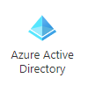
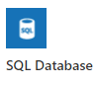
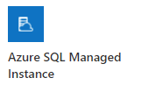
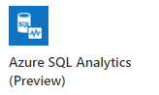
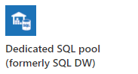
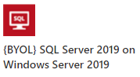
Role Based Access Control (RBAC)
Windows, AD, or preferably Azure AD makes this easier to accomplish.
Notes:
Role-based authentication is best when leveraging Active Directory (Azure or not), using security groups.
SQL Server Authentication can also be role based, but it exists within each SQL instance and is not a centrally managed security system, so it is not a scalable solution. Managing each individual user’s accounts and permissions manually per server is difficult to maintain. In general, we shouldn’t create database level credentials for people, with people’s names on them. And don’t fool yourself by creating admin1, admin2, admin3, for example. Accounts and groups already exist in active directory, let’s leverage it. “With Azure Active Directory authentication, you can centrally manage the identities of database users and other Microsoft services in one central location.”
A lot of what we’re talking about throughout this presentation applies to SQL Server, again whether it’s in a SQL Server instance on a VM in Windows or Linux or in Managed Instances, in all S.L.O.’s of Azure SQL DB, or in the SQL Server based nodes and pools of Big Data Clusters and Azure Synapse.
Azure Active Directory is an option in most of the SQL Server platforms on Azure, including the Dedicated SQL pools and Azure Synapse. Exceptions to this rule include Big Data Clusters, where SQL Authentication is the only option for SQL Server to SQL Server communication inside SQL Server Big Data Clusters, and Azure SQL Edge, currently only supports the built-in SQL Authentication mechanism.
Note here I am not talking about Azure users, groups, and permissions, permissions used to secure who can manage Azure resources. For the most part those permissions are completely different than permissions inside a database, for good reason. Azure architects don’t need direct database access, and database admins and developers don’t need Azure access.
Now, I’m not done singing the praise of using Active Directory authentication, I’ll continue to do that later, but I want to point out one more thing here.
https://docs.microsoft.com/en-us/sql/big-data-cluster/concept-security?view=sql-server-ver15#encryption-in-flight-and-other-security-mechanisms

Slide 11
Public Roles
Every login/user is a member of “public”
All logins/users inherit permissions granted to public.
Public is a server role that should never be granted any additional permissions.
Public is also a database role. Every database user/role belongs to a public database role.
Notes:
<read notes instead>
On these sample image here, you’ll notice the public roles at both the server and database level, and how that server role public checkbox is always checked. And it can’t be unchecked. Let’s talk about public.
Every login is a member of the public server role. Every user in each database is a member of the that database’s public database role.
Only very lazy and short-sighted developers would grant permissions to public, which allows every user that does or ever will exist, to inherit permissions.
Permissions assigned to the public role is a clear sign of lazy developers. Let’s red flag that anywhere we see it, and never recommend it in any tutorials, walkthroughs, etc.
There’s always got to be a better way than granting permissions to public.

Slide 12

Public
New permissions granted to public roles should trip a failure of any app or database security audit.
Pay attention JEDI: This is STIG SV-53924r1_rule
However, expected non-issue findings from Database Diagram feature.
A pain to unravel.
Notes:
<read slide first>The strategy to undo a security architecture based around public can be complicated, involves lots of testing, almost certainly requires participation from the developers to figure out what permissions are actually needed.
In my past life I helped a state national guard audit its GIS software, and this STIG led to a vendor software uninstallation.
Source: https://www.stigviewer.com/stig/microsoft_sql_server_2012_database/2013-11-10/finding/V-41398

Slide 13


Server Logins + Database Users
A Server Login is what authenticates a connection to SQL.
A Database User provides a Login with database access.
Notes:
<read slide first>
“Login” is a server level security principal.
“User” is a database level security principal.
Now, let’s talk about the different types of SQL Server Logins, they’re differentiated by how they authenticated to SQL Server.

Slide 14
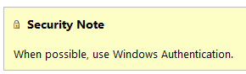
SQL Authenticated Logins
SQL Logins are authenticated by a SQL Server instance.
“Enforce Password Policy” encouraged, but not required!?
More administrative effort to maintain, migrate, secure.
Notes:
1. We’ll talk more about this but using SQL Authentication means each SQL Server is now an authority for its own credentials. If you have 10 SQL Server instances, that 10 different sets of logins and passwords to maintain, as opposed to one Active Directory.
2. Strongly encouraged to Enforce password policy, which can include password expiration, inheriting from the same settings in Windows.
Unfortunately, the password policy is optional! Password could be password, empty string, or the same as the user name.
Also, if a login doesn’t currently have the password policy enforced, you can check the box, but it doesn’t apply to the current password. So it’s way too easy to mark a login to apply policy, but have a password that is NOT strong enough to meet policy. The policy would only then be checked if it is changed.
3. Multiple failed SQL auth login attempts will Lock Out, which a DBA must resolve. Because these credentials are specific to each instance, it also means that SQL logins must be kept synchronized, more or less manually, between replicas in an Availability group
Finally, see here a plain and clear screenshot from Microsoft Docs. Use Windows Auth when possible. Don’t even enable SQL Auth unless you have to – it’s not enabled by default when you go to install SQL Server. You have to go out of your way to configure the instance in Mixed Mode, which enables SQL Logins and allows the built-in “sa” account to be enabled.

Slide 15
Windows Auth vs SQL Auth
In a typical enterprise business environment,
Windows Authentication means that:
account creation/termination,
security group membership,
password policy,
are all handled by an existing corporate security administration infrastructure.
Notes:
<read notes first>
So we’ve talked about how SQL auth really creates additional administrative overhead and the fragmentation of security for user and even application access. In comparison to Windows Authentication, specifically using Active Directory, SQL Authentication creates a decentralized security setup in each instance.
<click, read slide>
Centralizing account and password management, role assignment, these are good things to do from a governance standpoint and from the standpoint of, that thing you see on Certification Exams all the time? “Least amount of administrative effort”
Proper use of the Windows Authentication model creates Server Logins that are linked to Domain Accounts, Preferably linked to Security Groups in Active directory, not individuals, so that membership is also managed by your existing security infrastructure.
Windows Authenticated Logins can also be created for Windows users, local to the Windows Server. This isn’t ideal, creating some of the decentralization and redundancy issues common for SQL Authenticated logins. Don’t recommend them except for potential use in SQL Servers outside of a domain.
In any case, SQL Server inherits the password policy of the local Machine Policy, regardless of whether or not the local Machine Policy is inherited from a Domain Policy.

Slide 16
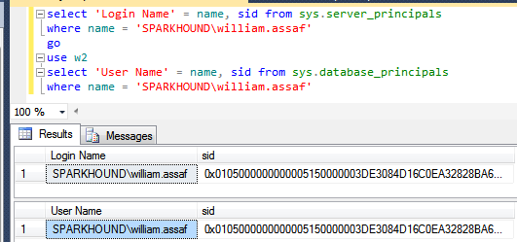
Logins + Users
A User can be linked to any Server Login
The names don’t actually have to match, but they should.
A SID (Security-IDentifier) is shared by User and Login.
Notes:
In Windows Authentication, that SID comes from the Windows provider, likely Active Directory. So in all SQL Servers where that domain account is used, it’s got the same SID.

Slide 17

Orphaned SID
DB Users can be disconnected from their SQL Auth Login.
Commonly occurs when a database is restored from one SQL instance to another.
Only with SQL Auth Logins, not Windows Auth Logins.
SQL Auth Login = local SID, Windows Auth Login = AD SID
Notes:
<read slide>
Now, why is that? Why would this only affect SQL Authenticated Logins?
<click>
It’s because, unless you specify a SID yourself, the SID for a SQL Server is generated locally at each SQL instance. If you go and create a Login named test on 5 different SQL server instances, you’ll get a Login named Test with five different SIDs. There is a way to create a SQL Auth Login with a pre-determined SID, this is how migrations happen, we’ll talk about this in a bit.
If you create a Windows Login for the same Active Directory account on five SQL instances, each Login has the same SID, because all five SQL instances got the SID from the same place, AD. Therefore any user associated with the Login will have the same SID, on any SQL instance. This is becomes incredibly important for Availability Groups, where is much simpler to distribute an Windows Login from AD to each replica, versus distributing a SQL Server authenticated login to each replica, scripting it out to use the same SID in each instance.

Slide 18
Fix Orphaned SID
To re-associate a database user to a server login:
ALTER USER username WITH LOGIN = loginname;
SELECT DBUser_Name = dp.name
, Login_Name = sp.name
FROM sys.database_principals AS dp
INNER JOIN sys.server_principals AS sp
ON dp.name = sp.name
WHERE sp.sid <> dp.sid;
Notes:
To fix an orphaned SID and reunite the Login with its User, the command is actually quite simple. You can also proactively identify orphaned logins by comparing their names and SID in SQL Server’s internal metadata.
<click>
Here’s the basic join, and there’s a script in this session’s toolbox that helps you quickly identify and repair orphaned SIDs. For experienced DBAs in the field, remembering to look for and fix orphaned SIDs is a necessary followup any time a database is restored from one server to another, for example, to update a dev or test environment from production.

Slide 19
Contained Databases
Moves authentication from the Server level directly to the Database level.
A contained database owner, for example, has full control over security in the database.
No server-level (or sysadmin) permissions necessary
Notes:
So again, we’ve been talking about the difference between Logins and Users and how the SID, not the name connects them. Now, don’t forget everything I just told you, but… well, there’s this thing called contained databases.
<read slide>
Contained database has no configuration dependencies on the instance, it can be easily moved to another instance.

Slide 20
Users With Passwords
What this means is that this syntax, which heretofore made no sense, on a contained database is perfectly valid:
USE [Contoso_DB];
CREATE USER [BI_User] WITH PASSWORD ='strongpassword’;
--or
CREATE USER [Contoso\BI_User];
Notes:
So, this is that asterisk on my early slide, talking about how only server logins have passwords, database users are linked to logins… well, most of the time.
A contained database user is a database user… with a password. Or, a database user directly tied to a Windows User that does not exist as a login.
Here in contained databases, the user is the contained, portable method of authentication to the database.
In SQL Server, Authentication to a contained database can be made with Windows Auth accounts which don’t exist as Logins, or Contained Database Users where the password is maintained inside the database. That’s not how regular databases in SQL Server work of course.
Agent jobs, system error messages, linked server information, and system settings are all inside the contained database instead of in system databases.

Slide 21
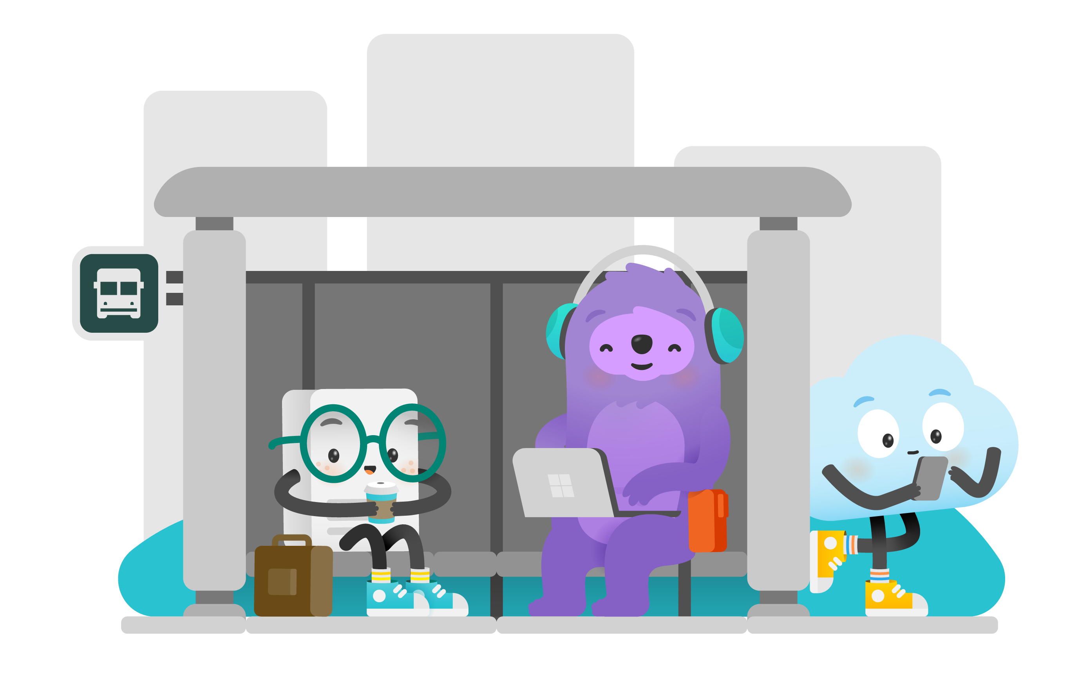
Contained Databases Sound Familiar
A platform where all the necessities for authentication and system objects are stored in the user database…
No system databases needed, so the database is easily portable between servers…
What does this sound like?
Azure SQL Database!
Image: https://docs.microsoft.com/en-us/azure/azure-sql/database/media/sql-database-paas-overview/architecture.png
Notes:
<read slide first>
This is the whole purpose of a contained database – unlimited portability on the back end, where Microsoft can move the database from instance to instance inside Azure without having any ties to the instance, everything is contained inside the database, including authentication. You don’t know or care what SQL instance your Azure SQL DB lives on, it’s completely contained and portable.
Microsoft developed contained databases for Azure, then brought the contained database feature to SQL Server, where it’s actually labeled partially contained because of some minor details.
Let’s briefly talk about how the authentication and security principals here are different.

Slide 22
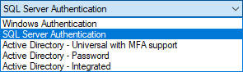
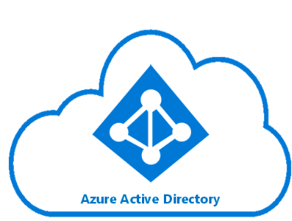
Azure SQL DB Authentication
Additional types of authentication since SSMS 2016
Image: https://docs.microsoft.com/en-us/azure/active-directory/hybrid/media/tutorial-federation/diagram.png
Notes:
The “Active Directory” dash options used for Azure AD only as Azure-based replacements for the Windows Authentication option. You can of course use SQL Auth for an Azure SQL Database, and that’s really your first and only option for environment once it is created, before you have integrated Azure AD.
For all the same reasons as Windows Authentication for SQL Server, using the Azure AD authentication in Azure SQL DB is superior.

Slide 23
Azure SQL Admin Logins
Azure SQL DB Servers are logical servers only.
Azure SQL Logins in the master system database can be shared across databases.
You initially create one full admin SQL Authenticated login per Azure SQL database logical server.
You must maintain logins on each Azure SQL logical server in active geo-replication or auto-failover groups.
Notes:
<read notes instead>
Azure SQL DB <airquote> “servers” are logical servers only. And I say logical server because in the Azure SQL Database product, all the databases are contained. Unlike the master system database in SQL Server, the “master” system database in Azure SQL DB here can only store certain objects, and behaves for the most part read-only.
<click>
Just like in SQL Server, Azure SQL Logins can be created and linked to a SQL Authenticated user in a user database, if you choose to create multiple Azure SQL databases in the same logical server.
<click>
Initially, the admin account that you specify upon creating an Azure SQL DB exists as a SQL authenticated user, with administrative rights to all databases on the server.
That’s the only full admin login on the logical server that uses SQL Authentication, and you can’t create another.
<click>
Like I said in Azure SQL DB, you can have logins in the master system database connected to users in a user database. And while this is the pattern you use for a SQL Server instance, more commonly you’ll have contained users in each database. And in Azure SQL Databases in active geo-replication or auto-failover groups, there’s addition complexity to maintain the Azure SQL DB logins on each logical server, manually, just like you would need to create and maintain the logins on each SQL Server replica of an availability group. In that case, leveraging contained database users only is probably going to be more reliable over time.

Slide 24
Azure SQL DB + Azure AD
You can create one Azure AD administrator account with full admin permissions as well, via the Portal.
You can use Azure AD accounts only for Azure SQL contained database users, Example:
CREATE USER [reportuser@domainname.onmicrosoft.com] FROM EXTERNAL PROVIDER; --different from SQL Server
Only Active Directory accounts can create other Active Directory accounts in Azure SQL Database.
Notes:
<read notes instead>
You can create a second full administrator, this time using Azure Active Directory. Just like in SQL Server, it can be created for an Azure Active Directory individual account or a security group, with a security group preferred. Often, I see database folks adding their own Azure AD account as THE Azure Active Directory admin. Watch out for that antipattern, and again use Azure AD security groups for the role of the DBA or Database Developer as much as possible.
<click>
You can then add other Azure AD accounts as Azure SQL contained database users, but not for Azure SQL logins.
<click>
Then, really the only complication is to remember that you have to be logged in with an Azure AD Account to create logins or contained users for other Azure AD accounts.

Slide 25
Database Object Security
Database Object Security
Notes:
Now I’m going to talk a little bit about database object permissions inside the database. I’ll assume you know the basics of GRANTing permissions, some of the basic read and write access permissions inside SQL Server as well. If you don’t, that’s ok, they’re obviously named. I’ll also assume you’re familiar with the table, the basic storage object of any relational database, where rows are queryable by end users. It’s the relationship between that data in the table, and the user’s end queries that I want to explore with a simple exercise.

Slide 26
Stored Procedures
Stored procedures require EXECUTE to run, and do not require underlying permissions (SELECT, INSERT, DELETE)
… Assuming:
1. the sproc doesn’t perform IDENTITY_INSERT on a table, which requires ALTER permissions not abstracted.
2. all the underlying objects have the same ownership chain.
3. the sproc does not use dynamic sql commands like: exec sp_executesql @SQL or EXEC(@SQL)
Notes:
<read notes first>
Stored procedures are kindof a big deal, and we take them for granted. A big Synapse competitor, Snowflake for example, just straight up doesn’t have stored procedures.
<read slide>
That last one is the big one, it’s the basic commands for executing strings of TSQL as dynamic SQL, this is a pretty big security no no and one common reason for why SQL injection attacks are successful. Stored procedures help insulate applications against SQL injection attacks. Even if you’re not a developer, everyone needs to be aware of what SQL injection attacks are because most public data entry forms and websites are under constant, automated SQL injection attacks.

Slide 27
Stored Procedures Security
Given those conditions, thanks to the database permission chain, you could in theory:
GRANT EXEC rights to sprocs that INSERT UPDATE and SELECT from a table.
GRANT no other permissions to the table!
Users can read data from table using sproc ONLY.
Notes:
That way, no unauthorized SQL statements can be injected into the database via vulnerabilities in data entry forms.

Slide 28
Views
Very similar to stored procedures
SELECT permission to query a VIEW will allow a user to SELECT data from table(s) without access to the tables.
GRANT SELECT ON [view] … is all you’d need.
Notes:
<read slide first, then notes>
(This is helpful!)
GRANT SELECT ON VIEW is all you’d need, instead of granting access to the underlying tables. In this way you can provide a horizontal or vertically partitioned view of data, excluding certain secure columns for example, or rows. This is a way to essentially perform row-level security. However, it’s not the only way.

Slide 29
Row Level Security
SQL 2016+ feature based on inline table-valued functions and a security policy.
Allows to you apply security policy to specific users, filtering specific tables.
Can block reads and writes against tables, without the use of triggers.
Notes:
<read notes>
This is a feature across all platforms, Azure SQL Database, Managed Instance, Azure Synapse Analytics, as well as SQL Server since SQL 2016.
<read slide>
This is useful, especially for reporting, but also for environments where databases have a variety of applications developed against them. You may have legacy databases with a mixed security environment of legacy and modern applications, perhaps low-code applications and mobile applications as well, and you want to help developers enforce a single, consistent row-level security policy at the database level. This feature like many others is very well documented with lots of samples on docs.Microsoft.com to help you implement.
https://docs.microsoft.com/sql/relational-databases/security/row-level-security

Slide 30
User-Defined Functions
Similar to views, a UDF will allow a user to SELECT data from tables that the user does not have access to.
Keep in mind the performance impact of functions can be severe, especially in the SELECT portion of a query.
Overuse of UDF’s are common causes for performance issues. High potential for cursor-like effects.
New features in 2017 and 2019 addressed UDF performance issues
Notes:
Some of the performance issues with UDF’s were addressed in the last two releases of SQL Server.
In SQL 2017 the performance feature Interleaved Execution helped with performance of Table Value Functions.
In SQL 2019 the new scalar function in-lining feature helped reduce the negative performance impact of abused scalar User Defined Functions.

Slide 31
Demonstrate how Stored Procedures, Views, and Functions abstract the permissions necessary to SELECT underlying table data. Security p1.sql – logged in as sysadmin Security p2.sql – logged in as testing user

Slide 32
Wrapup Section
Wrapup

Slide 33
More Resources
STRIKE trainings:
Cloud Security Incident Response Readiness Training
Security Foundations Training
Certification Exams:
Exam AZ-500: Microsoft Azure Security Technologies
Exam DP-203: Data Engineering on Microsoft Azure (beta)
Learn:
Security Overview - Azure SQL Database & Azure SQL MI
Securing SQL Server - SQL Server
Secure your data with Azure SQL - Learn

Slide 34
Thank you aka.ms/campfeedback

Slide 35

William Assaf
he/him
Senior Content Developer
SQL-Docs aka Rogue1
in/williamdassaf
@william_a_dba

